Slide 1
Wave Analysis
Eli Andrae

Slide 2
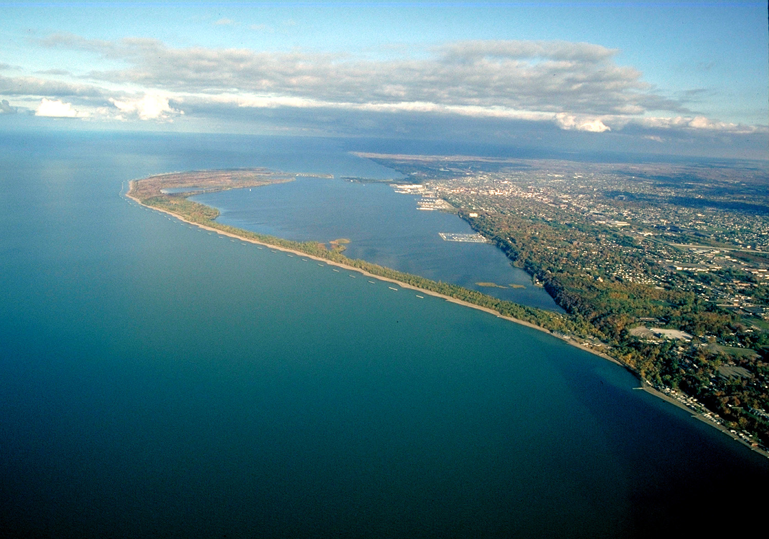
Motivation
I own a small fishing boat that I regularly take 5+ miles offshore on Lake Erie
Essentially a canoe with an outboard attached
Lake is known to be unpredictable
Goal: Gain deeper insights of how the lake works

Slide 3
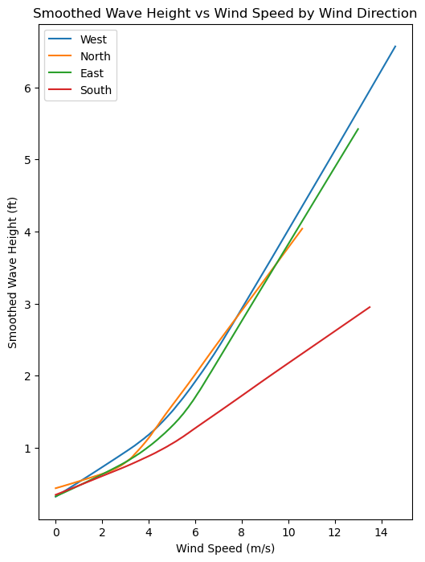
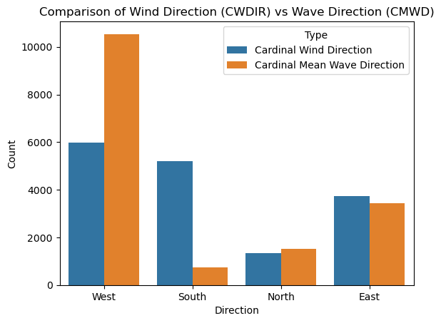
Exploration

Slide 4
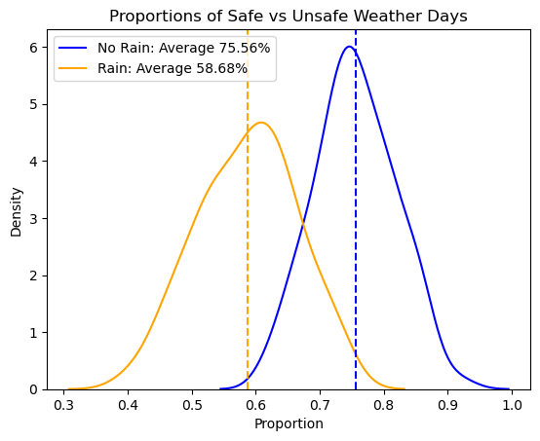
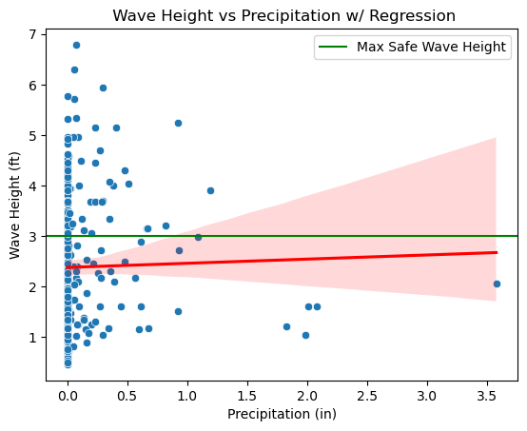
Inference

Slide 5
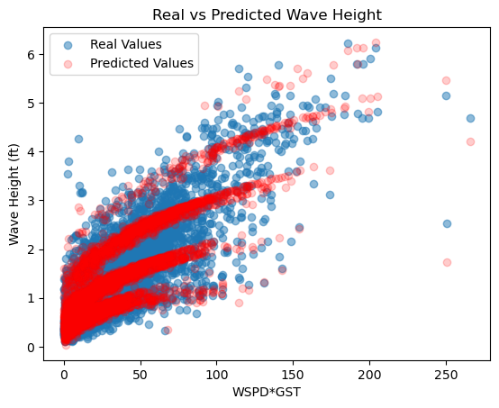
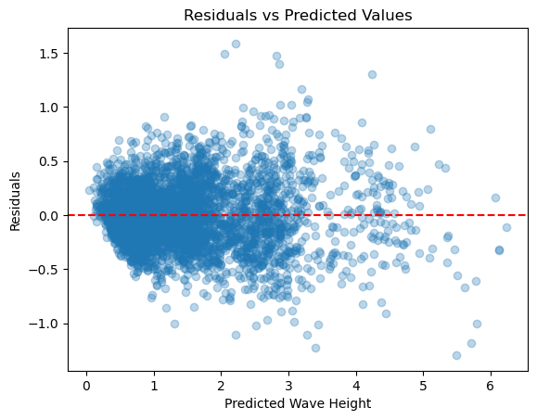
Prediction

